Slide 1
Improved Image labeling
Jeremy Deng
Erik Maldonado

Slide 2
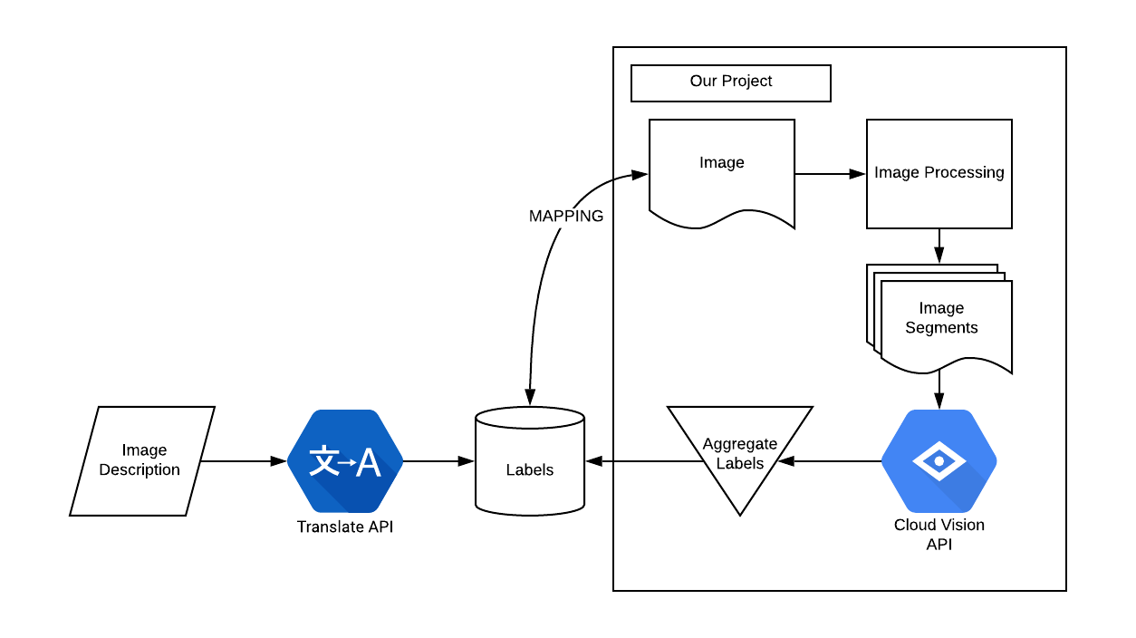
Full Scope: Labeling Limitations
Variance in subjectivity of humans
Language limitations for image search

Slide 3
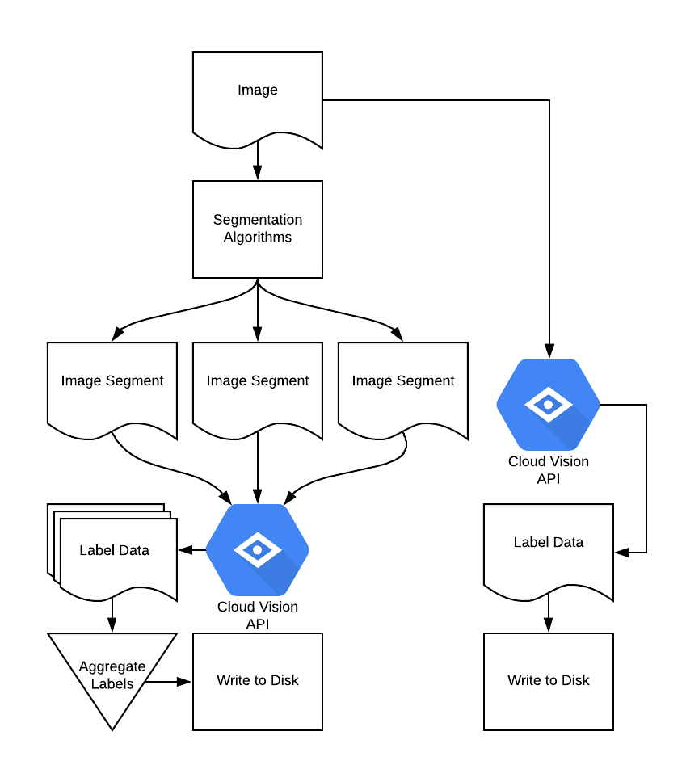
Our Approach
Input image is segmented using:
K-Means clustering algorithm
GrabCut algorithm
Segmented images sent to google’s vision api
We don’t have to train a model

Slide 4
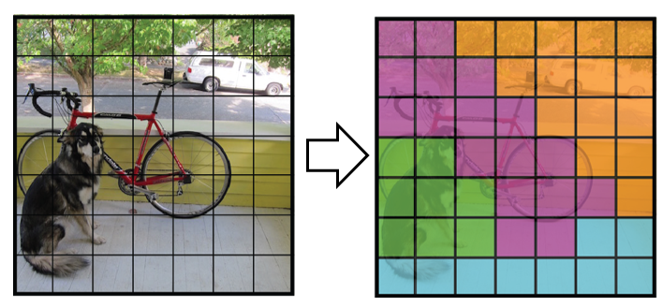
Similar to Class Probability Map
Each cell given a class based on probabilities
We want all the classes for each segment above a probability

Slide 5
K-mean cluster
Initialize centroid with random pixel color value
For a given iterations
calculate the euclidean distance between each pixel value and centroids
Assign pixel to centroid(cluster)
Update the centroid
We stop after certain iterations or two of the labeled set are the same

Slide 6
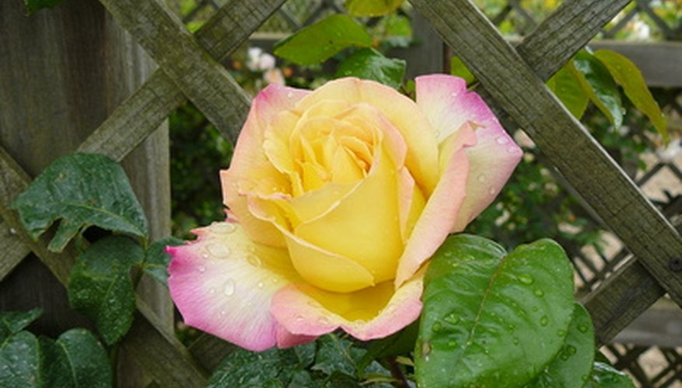
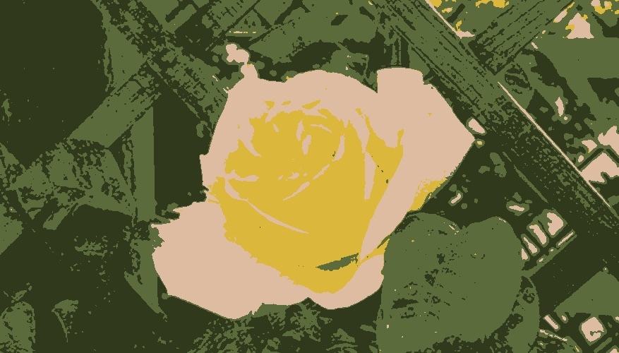
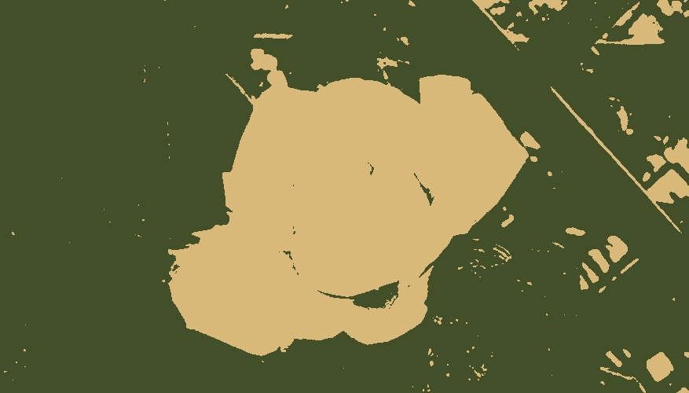
K- mean cluster
Left top: original rose picture
Left bottom: K value(cluster): 2
Right: K value(cluster): 4

Slide 7
K-mean cluster
Pros
Opencv
Good to use when object is unicolor and have distinct coloring than background
Cons
Computational expensive
Does not provide segmented image based on object
Noise pixel

Slide 8
GrabCut Algorithms
User specific bounding windows
Estimate color distribution based the bounding area and background(gaussian mixture model)
https://en.wikipedia.org/wiki/GrabCut
https://docs.opencv.org/master/d7/d1b/group__imgproc__misc.html#ga909c1dda50efcbeaa3ce126be862b37f

Slide 9
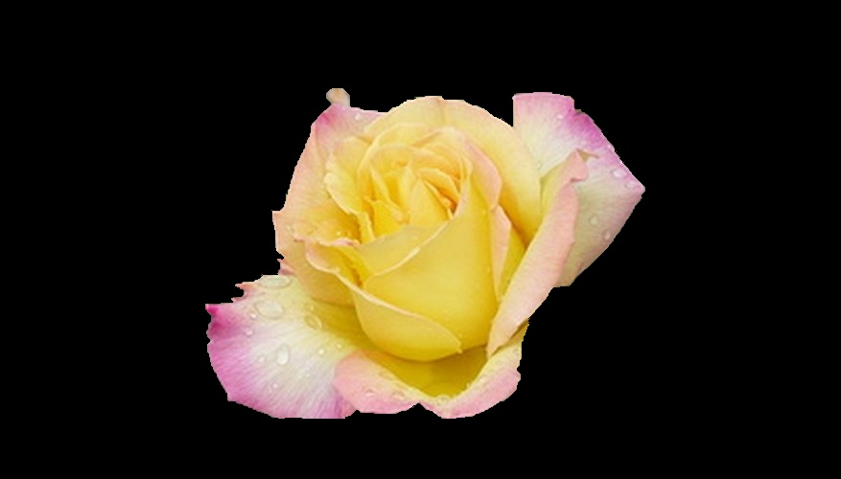
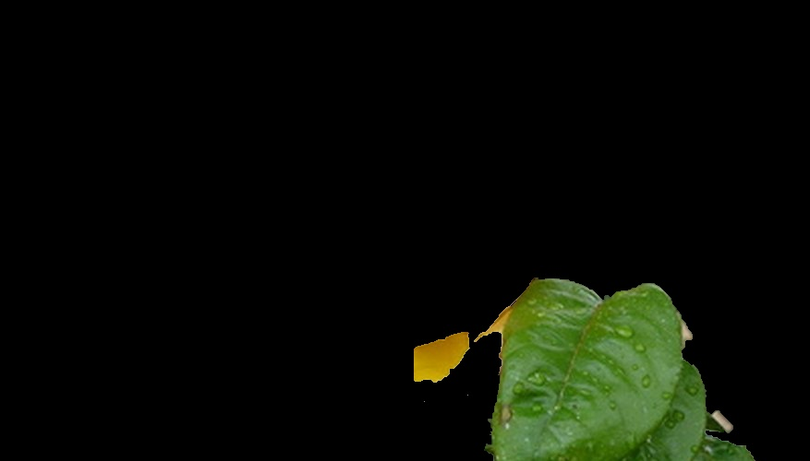
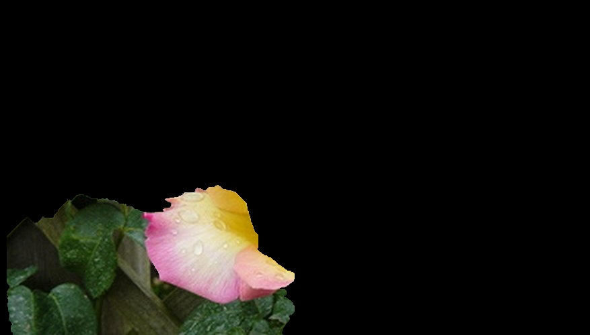
GrabCut
Specified four quadrant and a center window
Using opencv GrabCut call

Slide 10
GrabCut Algorithms
Pros
Opencv function call
Fast (around 7 sec each segments for the rose(100KB))
Cons
Advanced math, a lot math(hard to understand)
Needed user to specify the window size

Slide 11
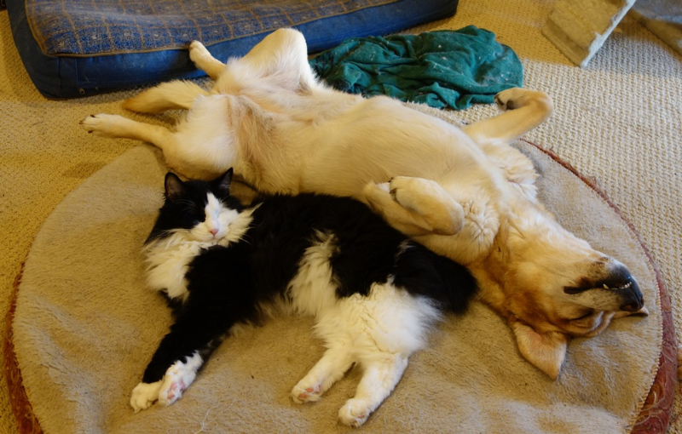
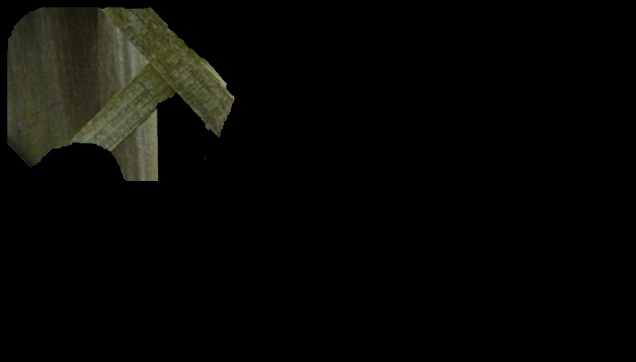

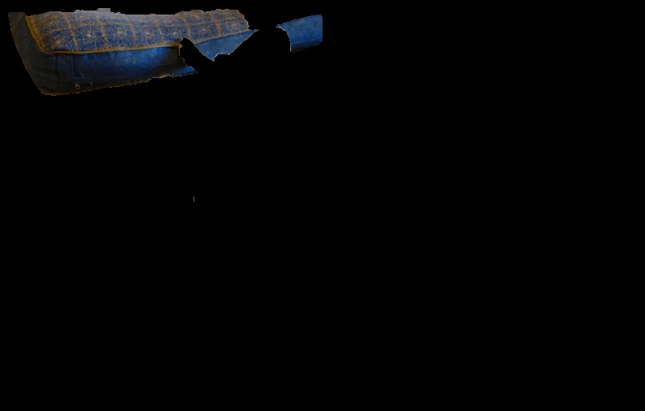
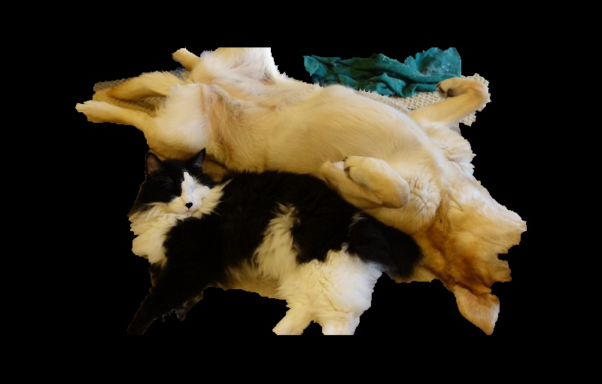

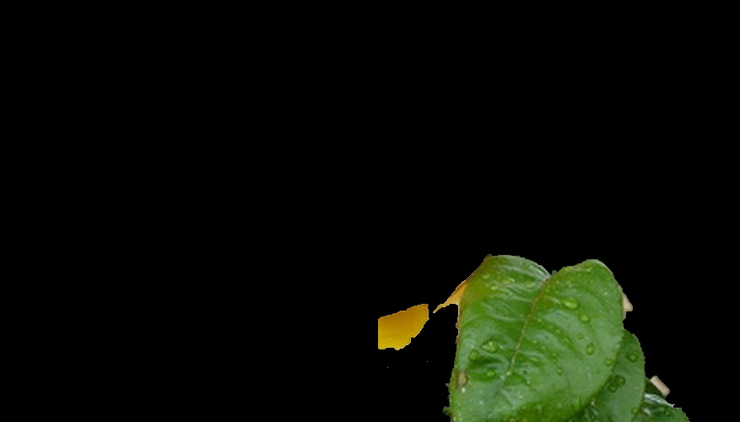
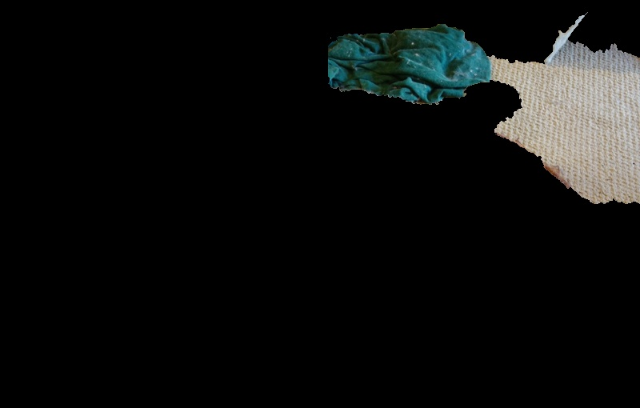
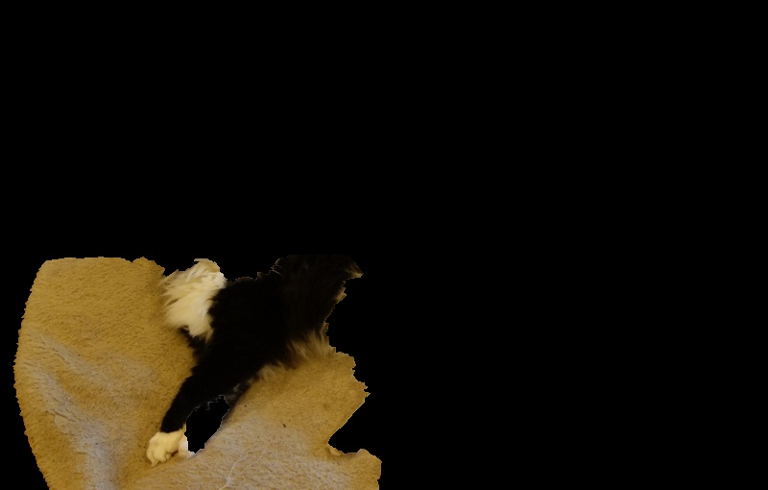
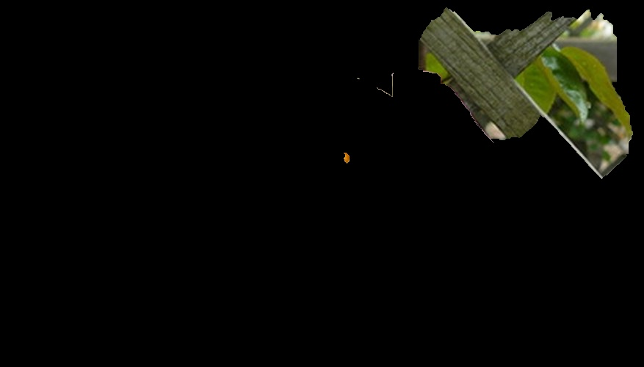
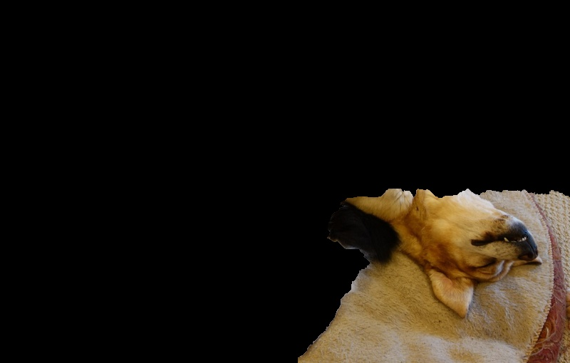
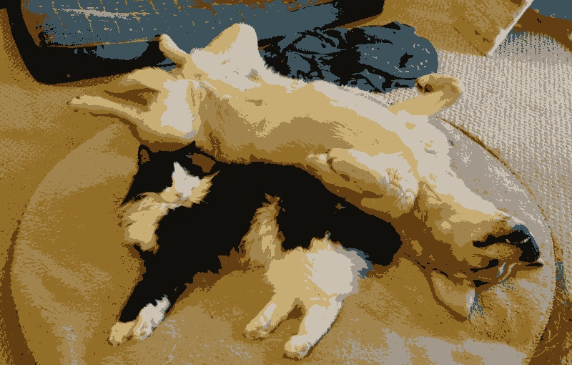
Results: 35-55% more labels
Extra Labels generated
Art*
Black
Black-and-white*
Blue
Cave
Darkness*
Fawn
Light
Midnight
Night
Organism
Photography
Plant
Pug
Rock
Shadow
Sky
Space
Tail
World
Yellow
Extra Labels generated
Art*
Black-and-white*
Bud
Close-up
Cut Flowers
Darkness*
Font
Green
Hibiscus
Leaf
Macro photography
Mallow Family
Monochrome
Monochrome photography
Night
Mavales
Space
Still life photography
Yellow

Slide 12
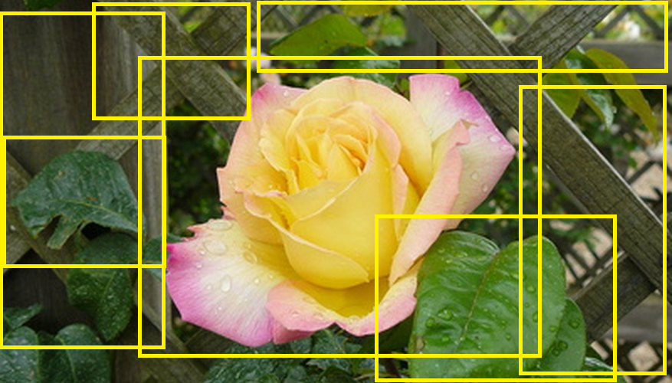
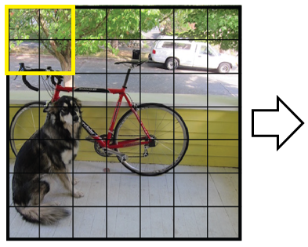
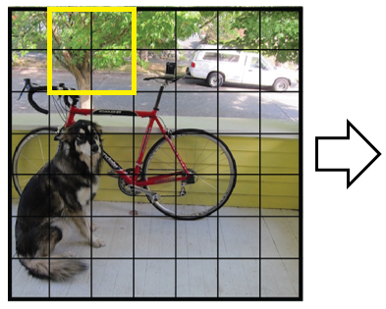
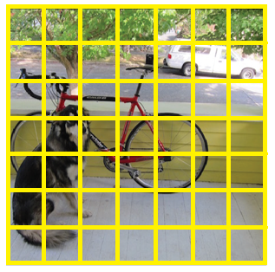
Improvements
Sliding window chunk segments
Image cropping
Mean shift algorithm and other techniques

Slide 13
Problems
Extracting image abstractions
Extracting object state
Could not control labels returned based on probability

Slide 14
Questions？

Slide 15
Reference
https://www.geeksforgeeks.org/k-means-clustering-introduction/
https://en.wikipedia.org/wiki/GrabCut
https://docs.opencv.org/master/d5/d38/group__core__cluster.html#ga9a34dc06c6ec9460e90860f15bcd2f88
https://towardsdatascience.com/how-do-self-driving-cars-see-13054aee2503
https://cloud.google.com/vision/

